Slide 1
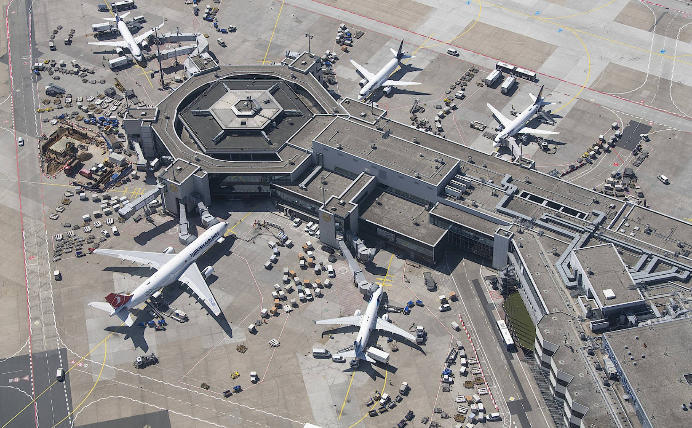
Milestone 1: Requirements Engineering
Kaan Baylan, Stefan Haslhofer, Simon Primetzhofer, Jonas Reichhardt

Slide 2
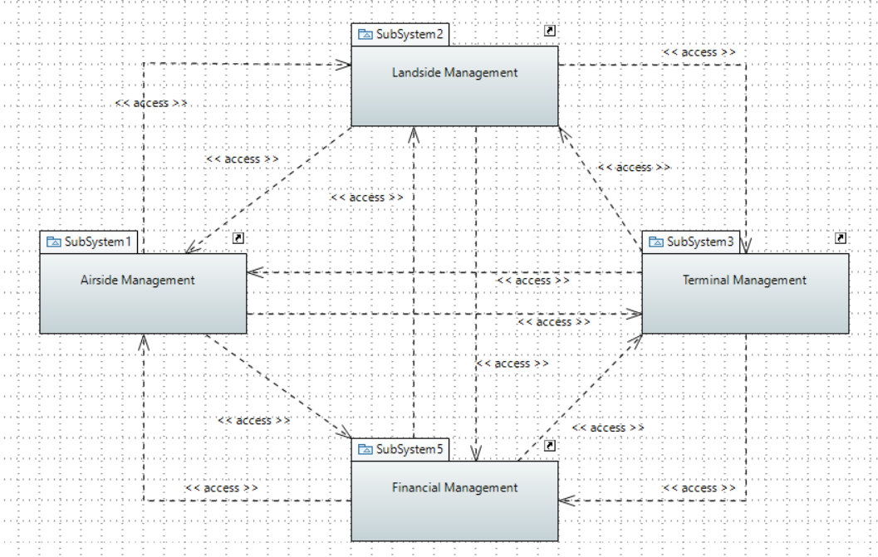
Overall Architecture

Slide 3
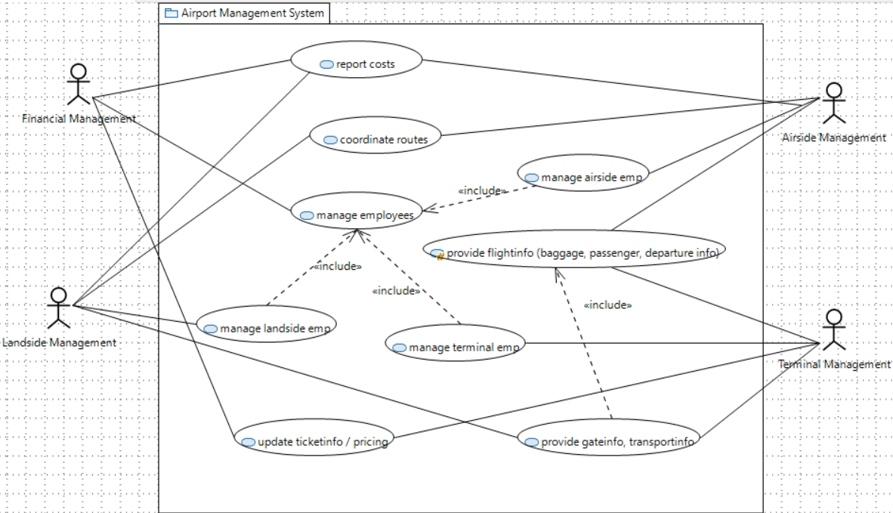
Overall Architecture
Terminal Management requests passenger/cargo transport from Landside Management
1
Landside Management requests gate and transport information from Terminal Management
2
Terminal Management assigns gate
3
Terminal Management forwards baggage to transportation units
4
Terminal Management and Airside management coordinate flight details to ensure that baggage gets delivered correctly and on time
5
Landside Management transports baggage and passengers to the airplane
6
provide gateinfo, transportinfo
provide gateinfo, transportinfo

Slide 4
provide gateinfo, transportinfo
Airside Management requests flight information from Terminal management (scheduled departure/arrival)
1
Terminal Management adjusts departure/landing time according to check-in status of passengers
2
Airside Management provides actual departure/landing time (possible delays)
3
Terminal Management displays possibly changed flight information to passengers
4
Terminal Management coordinates baggage and passenger transportation according to aircraft status
5
Terminal Management requests passenger/cargo transport from Landside Management
1
Landside Management requests gate and transport information from Terminal Management
2
Terminal Management assigns gate
3
Terminal Management forwards baggage to transportation units
4
Terminal Management and Airside management coordinate flight details to ensure that baggage gets delivered correctly and on time
5
Landside Management transports baggage and passengers to the airplane
6

Slide 5
<<Include>> Provide flightinfo
Airside management requests fuel truck, stair truck, etc. from Landside Management
1
Landside Management requests parking location of aircraft
2
Airside Management provides parking location and arrival/departure time
3
Landside Management calculates needed resources
4
Landside Management plans best route for vehicles
5
Landside Management assigns driver
6
Landside Management executes requested service
7
Airside Management requests flight information from Terminal management (scheduled departure/arrival)
1
Terminal Management adjusts departure/landing time according to check-in status of passengers
2
Airside Management provides actual departure/landing time (possible delays)
3
Terminal Management displays possibly changed flight information to passengers
4
Terminal Management coordinates baggage and passenger transportation according to aircraft status
5
Terminal Management requests passenger/cargo transport from Landside Management
1
Landside Management requests gate and transport information from Terminal Management
2
Terminal Management assigns gate
3
Terminal Management forwards baggage to transportation units
4
Terminal Management and Airside management coordinate flight details to ensure that baggage gets delivered correctly and on time
5
Landside Management transports baggage and passengers to the airplane
6

Slide 6
Coordinate routes
Airside management requests fuel truck, stair truck, etc. from Landside Management
1
Landside Management requests parking location of aircraft
2
Airside Management provides parking location and arrival/departure time
3
Landside Management calculates needed resources
4
Landside Management plans best route for vehicles
5
Landside Management assigns driver
6
Landside Management executes requested service
7
Airside Management requests flight information from Terminal management (scheduled departure/arrival)
1
Terminal Management adjusts departure/landing time according to check-in status of passengers
2
Airside Management provides actual departure/landing time (possible delays)
3
Terminal Management displays possibly changed flight information to passengers
4
Terminal Management coordinates baggage and passenger transportation according to aircraft status
5

Slide 7
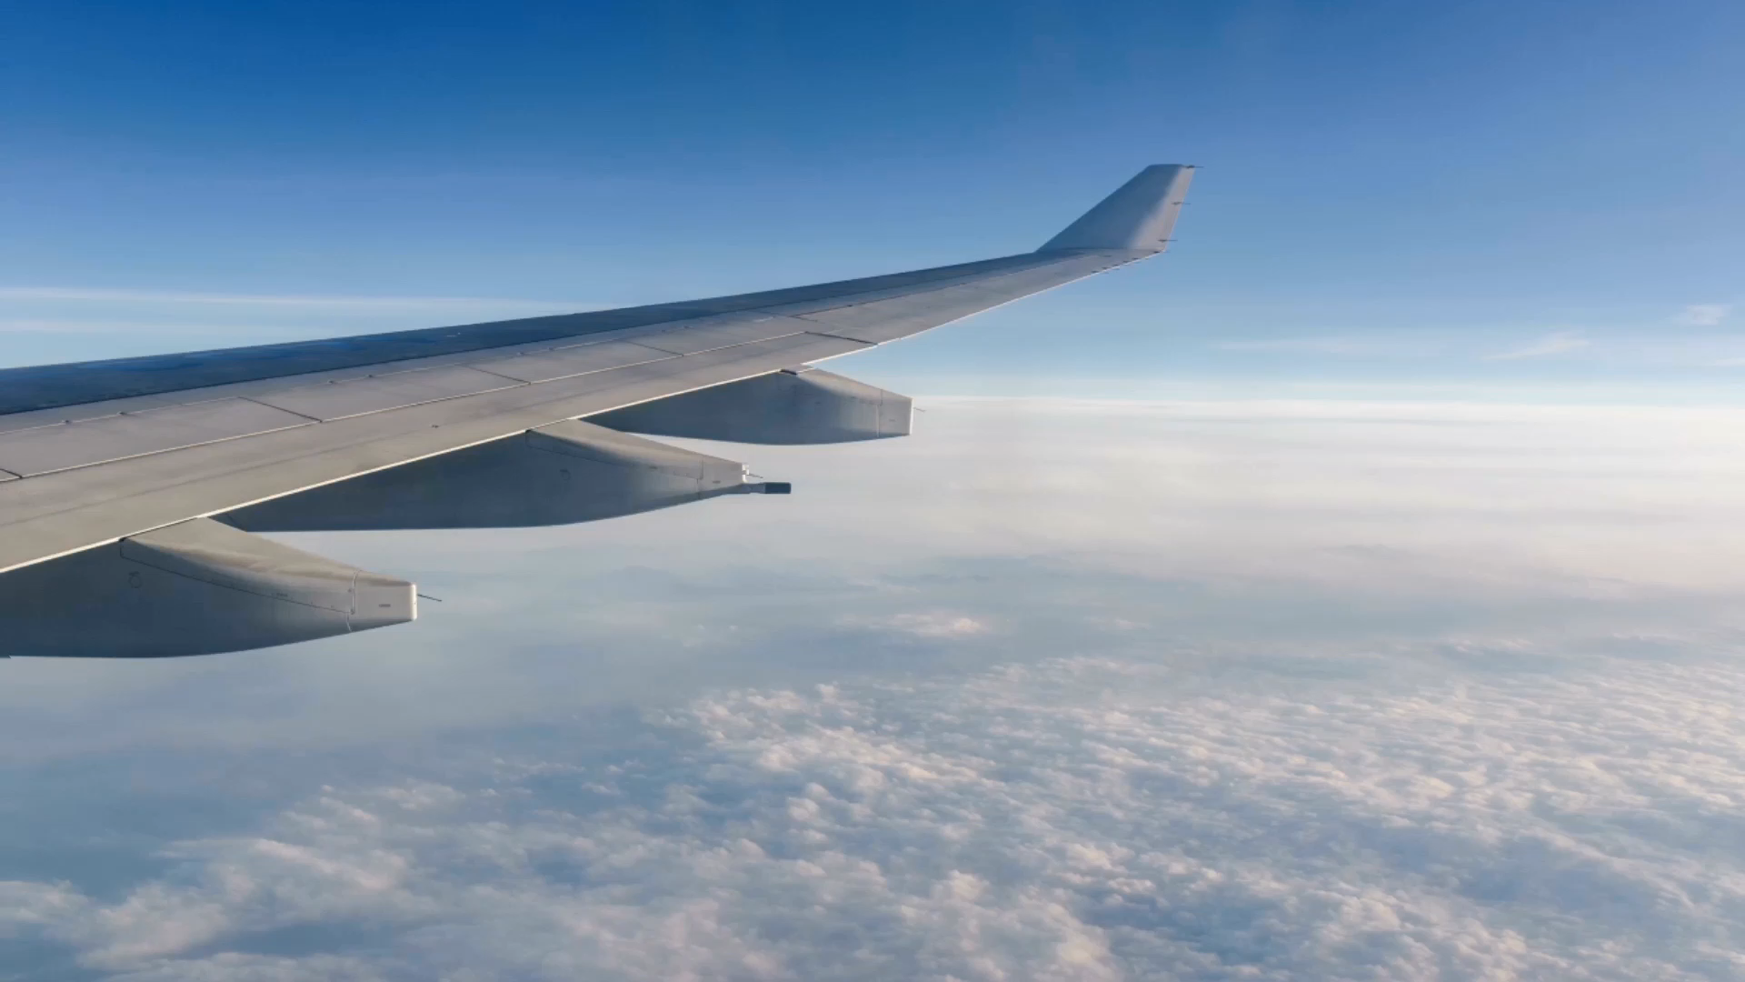
Airside Management

Slide 8
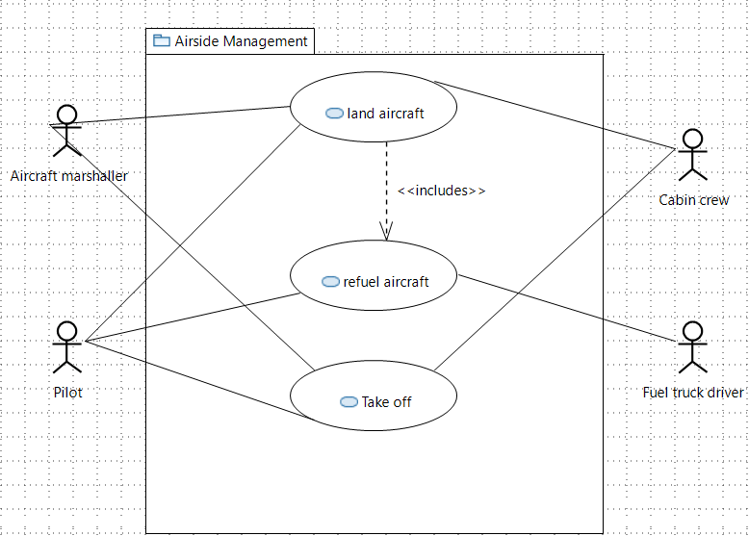
Airside Management
Land aircraft

Slide 9
Land aircraft
Pilot requests landing clearance from the aircraft marshaller
1
Pilot notifies cabin crew that the aircraft will land soon
2
Cabin crew informs the passengers that they should put on their seatbelts
3
Aircraft marshaller gives clearance and provides the landing strip
4
Pilot performs landing
5
Aircraft marshaller provides a gate number and the parking spot after the passengers left.
6
Aircraft marshaller signals instructions to the pilot to ease parking.
7
Pilot acknowledges the information provided
8
Cabin crew departs the passengers row-wise
9

Slide 10
Land aircraft
Pilot requests landing clearance from the aircraft marshaller
1
Pilot notifies cabin crew that the aircraft will land soon
2
Cabin crew informs the passengers that they should put on their seatbelts
3
Aircraft marshaller gives clearance and provides the landing strip
4
Pilot performs landing
5
Aircraft marshaller provides a gate number and the parking spot after the passengers left.
6
Aircraft marshaller signals instructions to the pilot to ease parking.
7
Pilot acknowledges the information provided
8
Cabin crew departs the passengers row-wise
9

Slide 11
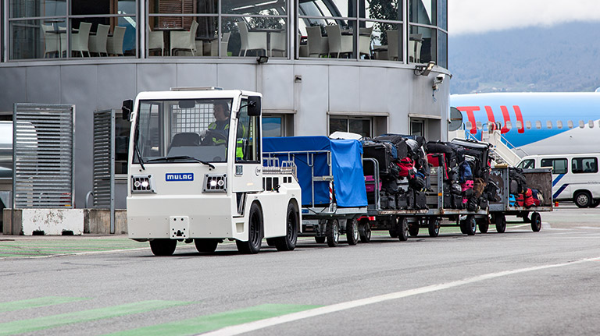
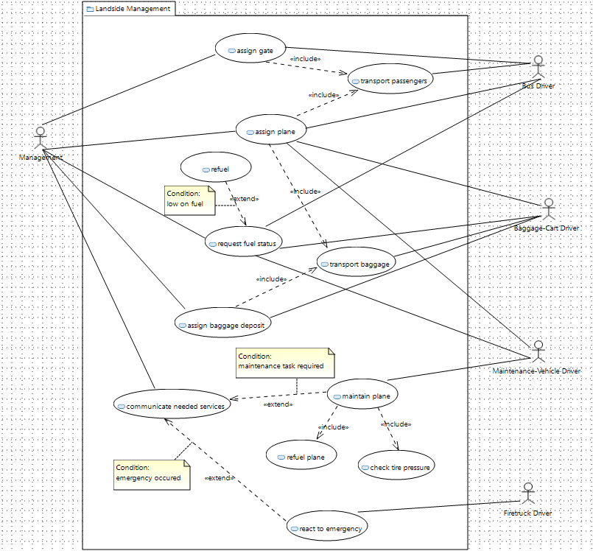
Landside management
Pilot requests landing clearance from the aircraft marshaller
1
Pilot notifies cabin crew that the aircraft will land soon
2
Cabin crew informs the passengers that they should put on their seatbelts
3
Aircraft marshaller gives clearance and provides the landing strip
4
Pilot performs landing
5
Aircraft marshaller provides a gate number and the parking spot after the passengers left.
6
Aircraft marshaller signals instructions to the pilot to ease parking.
7
Pilot acknowledges the information provided
8
Cabin crew departs the passengers row-wise
9

Slide 14
Maintain plane
Maintenance vehicle driver drives to plane
1
Maintenance vehicle driver arrives
2
Maintenance vehicle driver refuels plane
3
Maintenance vehicle driver check tire pressure
4
Maintenance vehicle driver reports status back to management
5
Maintenance vehicle driver drives back to garage
6
Maintenance vehicle driver awaits new orders
7

Slide 15
<<Include>> Refuel PLANE
maintenance vehicle driver opens fuel hatch of plane
1
maintenance vehicle driver attaches gasoline hose to hatch
2
maintenance vehicle driver starts pumping kerosine
3
maintenance vehicle driver stops pumping
4
maintenance vehicle driver disconnects gasoline hose
5
maintenance vehicle driver closes hatch
6
maintenance vehicle driver reports amount of gasoline used to management
7
maintenance vehicle driver double checks if planes fuel hatch is closed
8

Slide 16
<<Include>> Refuel PLANE
maintenance vehicle driver opens fuel hatch of plane
1
maintenance vehicle driver attaches gasoline hose to hatch
2
maintenance vehicle driver starts pumping kerosine
3
maintenance vehicle driver stops pumping
4
maintenance vehicle driver disconnects gasoline hose
5
maintenance vehicle driver closes hatch
6
maintenance vehicle driver reports amount of gasoline used to management
7
maintenance vehicle driver double checks if planes fuel hatch is closed
8

Slide 17
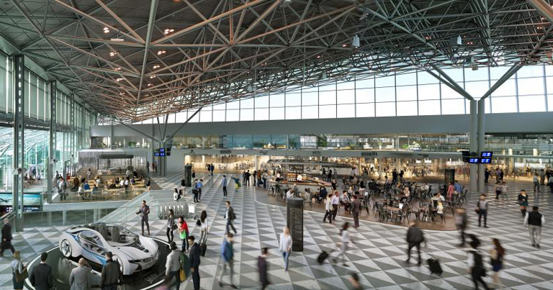
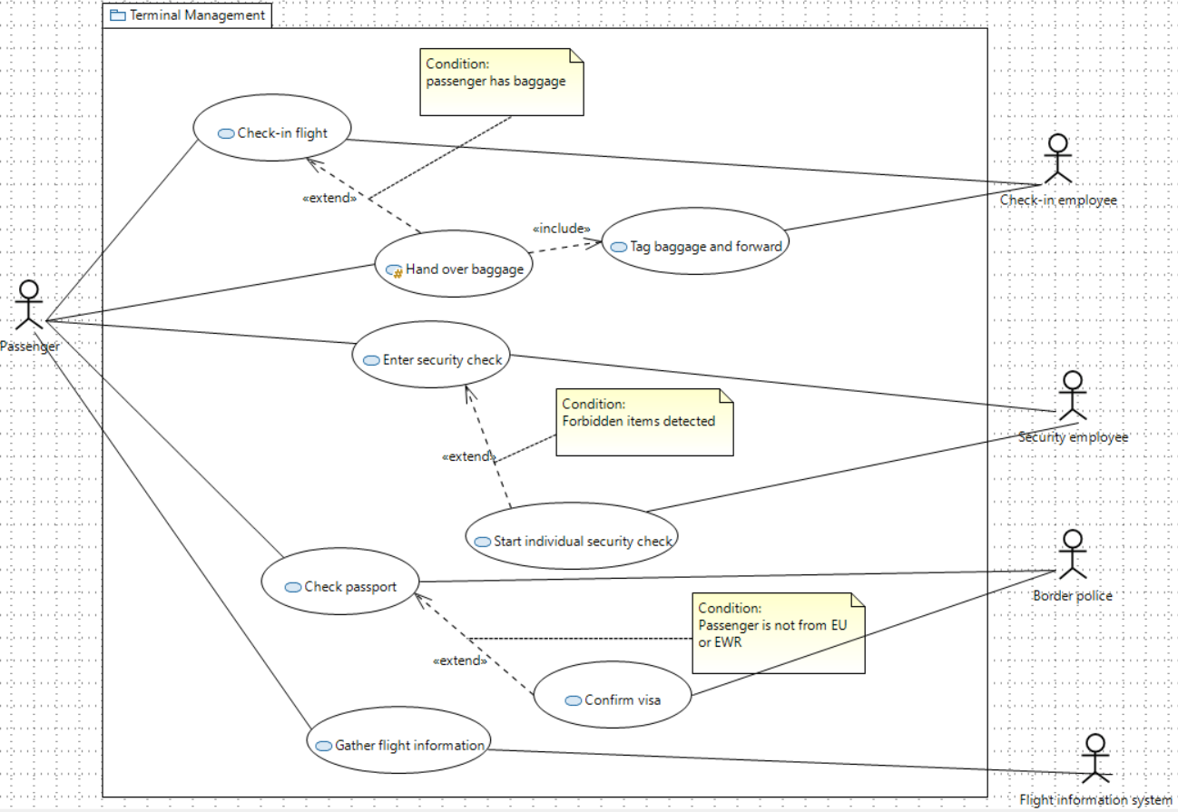
Terminal Management

Slide 18
Passenger approaches check-in counter
1
Check-in employee asks for passport
2
Passenger hands over passport
3
Check-in employee checks identity
4
Check-in employee prints out flight tickets
5
If the passenger has some baggage, he/she hands it over to the check-in employee
6
If Step 6 was executed, the check-in employee tags the baggage and forwards it
7
Check-in employee gives back the passport including the flight tickets
8
Passenger leaves counter
9

Slide 19
Check in flight
Passenger approaches check-in counter
1
Check-in employee asks for passport
2
Passenger hands over passport
3
Check-in employee checks identity
4
Check-in employee prints out flight tickets
5
If the passenger has some baggage, he/she hands it over to the check-in employee
6
If Step 6 was executed, the check-in employee tags the baggage and forwards it
7
Check-in employee gives back the passport including the flight tickets
8
Passenger leaves counter
9

Slide 20
Check in flight
Passenger approaches check-in counter
1
Check-in employee asks for passport
2
Passenger hands over passport
3
Check-in employee checks identity
4
Check-in employee prints out flight tickets
5
If the passenger has some baggage, he/she hands it over to the check-in employee
6
If Step 6 was executed, the check-in employee tags the baggage and forwards it
7
Check-in employee gives back the passport including the flight tickets
8
Passenger leaves counter
9

Slide 21
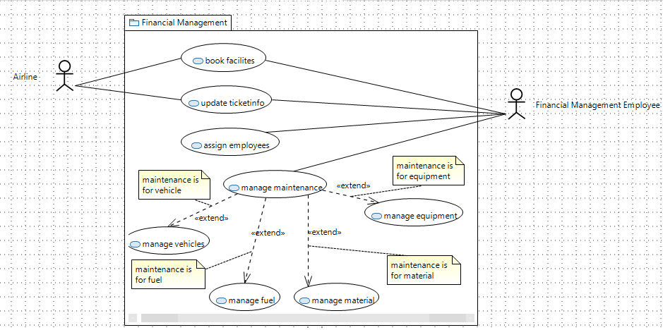

Financial management
Passenger approaches check-in counter
1
Check-in employee asks for passport
2
Passenger hands over passport
3
Check-in employee checks identity
4
Check-in employee prints out flight tickets
5
If the passenger has some baggage, he/she hands it over to the check-in employee
6
If Step 6 was executed, the check-in employee tags the baggage and forwards it
7
Check-in employee gives back the passport including the flight tickets
8
Passenger leaves counter
9

Slide 22
Airline contacts FME
1
FME gives Airline information about which facilities are free
2
Airline gives info about which facilities they would like to book
3
FME gives Airline a contract about the booking
4
Airline accepts and signs contract
5
Airline pays the discussed amount
6
FME registers the facilities as booked
7

Slide 23
Book Flight
Airline contacts FME
1
FME gives Airline information about which facilities are free
2
Airline gives info about which facilities they would like to book
3
FME gives Airline a contract about the booking
4
Airline accepts and signs contract
5
Airline pays the discussed amount
6
FME registers the facilities as booked
7

Slide 24
Thanks for your attention
Airline contacts FME
1
FME gives Airline information about which facilities are free
2
Airline gives info about which facilities they would like to book
3
FME gives Airline a contract about the booking
4
Airline accepts and signs contract
5
Airline pays the discussed amount
6
FME registers the facilities as booked
7

